Slide 1
CSE 145: Developing a Multi-Faceted Integrated Navigation System For Triton AI Racing
Michael Ruddy

Slide 2
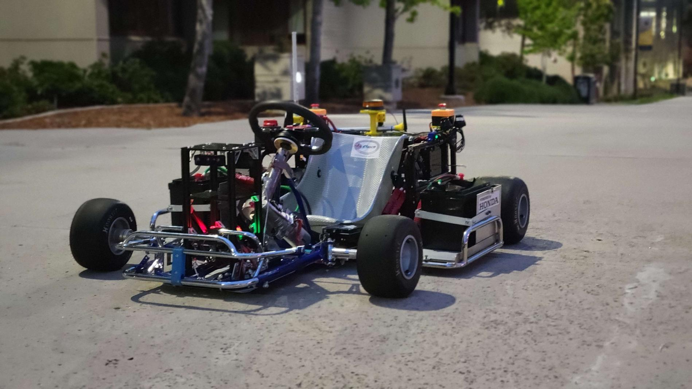
BiG Goal: Fast, Smart Karts
Triton-AI
AKS(Autonomous Karting Series)- Learn Track, Race
My job - GPS,IMU,Atlas, P1 SDK, Artemis

Slide 3
Objectives
Fuse/Test the IMU and GNSS in the Atlas system, larger scale vehicle tests with the project's system integrated. (current)
Test IMU/GNSS Fusion on both the Artemis Board and P1 SDK Board, and comparing the findings of all three using test data and quantifiable comparisons. (soon)
Fuse the Razor IMU with LIDAR Livox MID360 to enable odometry on the vehicle. (down the line)

Slide 4
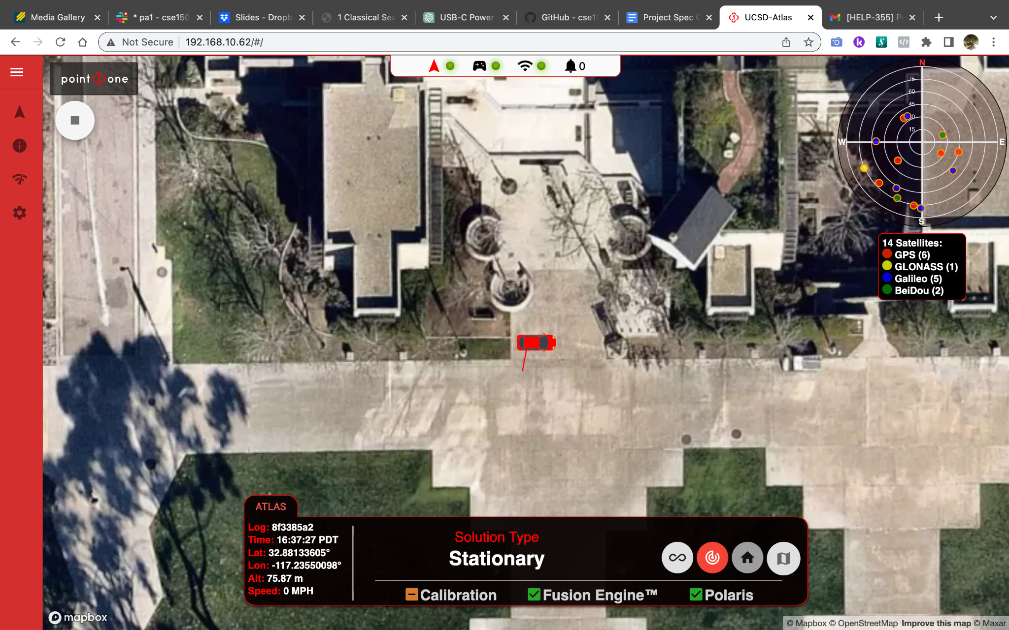
Accomplishments

Slide 5
Hiccups
Ran into errors downloading drivers
Couldn’t connect GPS
Had to be outside, still need ethernet
USB-C didn’t cut it
Progress isn’t always going forward

Slide 6
The Plan
Week 6: Work with the team to integrate the Atlas, with complete GNSS/IMU integration into the vehicle cart and test it
Week 7: Ship the go-cart and go back to working on the scaled P1 driven test robot.
Week 8: Compare IMU data from the P1 with that of the Artemis
Week 9: Learn how to fuse razor IMU with LIDAR Livox MID360 to enable odometry
Week 10 Complete Project Report and finalize collecting all data

Slide 7
Conclusion
I’m learning a lot so far, have had a lot of early struggles, but I’m confident that I can deliver a high-quality outcome for this project.
Purdue Race is this weekend so the Integration of the Atlas is urgent!

